Slide 1
Interpretable Glioma Classification via Cluster-Guided Multi-Omics Modelling
Group 2: Gyeongsil Kim, Daeho Lee, Jingwen Luo

Slide 2
01
Introduction

Slide 3
Background
Glioma = molecularly heterogeneous brain tumours [1]
Low-Grade Glioma (LGG) & Glioblastoma Multiforme (GBM) = legacy clinical terms [2]
based on prognosis and histology → not strict definition
The Problem
LGG & GBM may share molecular profiles → Blurred boundary [1,3]
Some LGGs = GBM-like, Some GBMs = less aggressive
Modern Shift in Classification
WHO 2016/2021 → Molecular-based classification [2, 4]
IDH mutation, 1p/19q codeletion, CDKN2A/B deletion
GBM = IDH-wildtype + specific alterations ≠ just grade IV
The Limitations of Previous Works
No dynamic sub-grouping beyond fixed markers, e.g. IDH, 1p/19q [1]
Applied either clustering or classification, not both [5]

Slide 4
Goal & Strategies
Our Goal
To integrate unsupervised clustering with supervised learning
→ to build interpretable, subgroup-specific classification models
Our Strategies
Identify ambiguous glioma subgroups via dynamical clustering
Leverage the full potential of multi-omics data
Develop cluster-specific classifiers

Slide 5
Overview of Our Project
TCGA-LGG
Step 1
Step 2
Step 3
Step 4
CNV
Intra-cohort preprocessing
Inter-cohort preprocessing
Data modelling
Biological interpretation
Methylation
RNAseq
Data cleaning
*Sample filtering
Data splitting
Clustering
Cluster annotation
Protein
Data cleaning
*Feature filtering
Cluster-specific classification
Feature importance analysis
SNV
GBM Methylation array integration across platforms (27K & 450K)
TCGA-GBM
Batch correction
Model evaluation
Survival analysis
CNV
Feature selection
Methylation
RNAseq
Scaling
Layer-wise LGG-GBM integration
Protein
Multi-omics integration
SNV

Slide 6
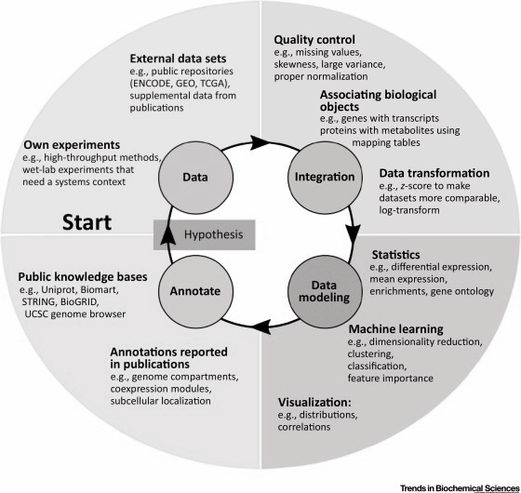
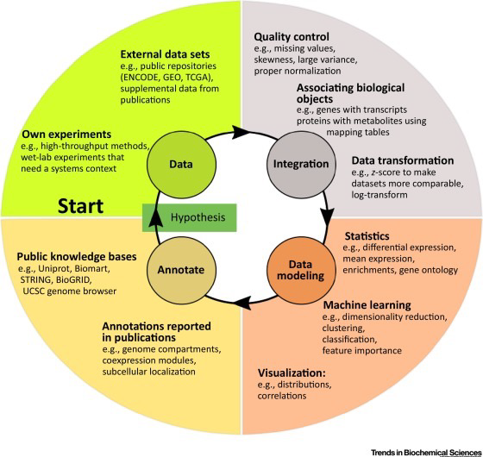
02
Data
From the Public Repository: TCGA

Slide 7
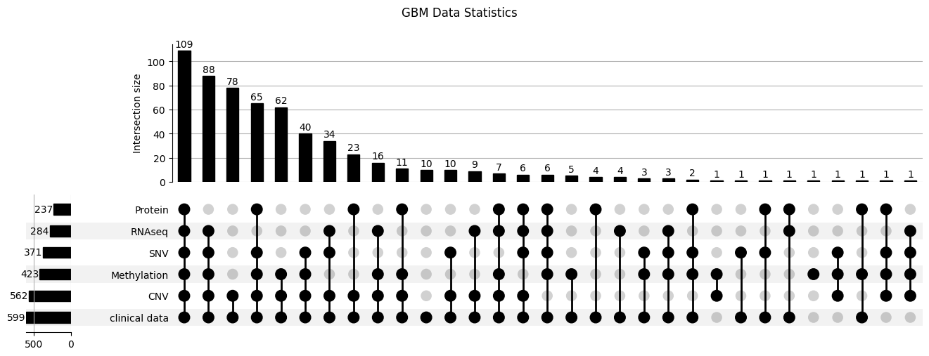
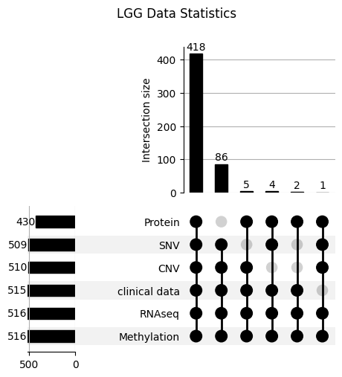
TCGA-LGG/GBM
CNV, SNV and protein expression data from UCSC Xena browser
Ready-to-use data in matrix form
RNA-seq, methylation, and clinical data from the GDC data portal
More samples available → Need of data pre-processing

Slide 8
03
Integration
From Cohort-level to Omics-level

Slide 9
Intra-Cohort Preprocessing
Sample Filtering
Problem 1: Samples without clinical data
Solution: Filtered out 5 GBM & 1 LGG samples for the downstream analysis

Slide 10
Intra-Cohort Preprocessing
Sample Filtering
Problem 2: Samples with ≤1 omics layer
Solution: Filtered out 102 GBM samples to obtain reliable latent vectors from MOFA+

Slide 11
Intra-Cohort Preprocessing
Sample Filtering
Checked whether each sample had ≤50% missing values across the omics layers available for that sample
to obtain reliable latent vectors from MOFA+
→ No such samples
Total # of GBM samples: 495
Total # of LGG samples: 515

Slide 12
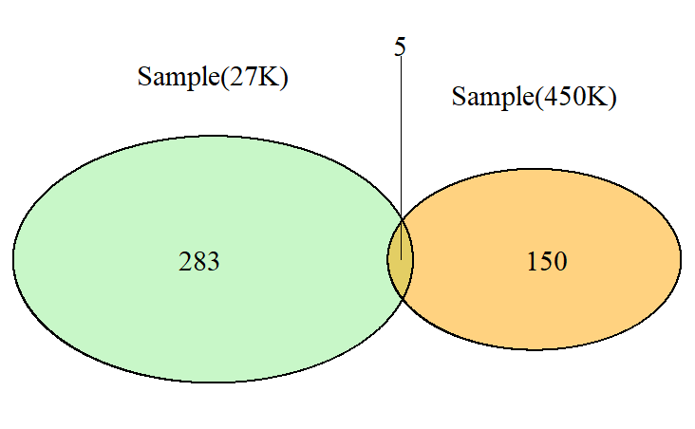

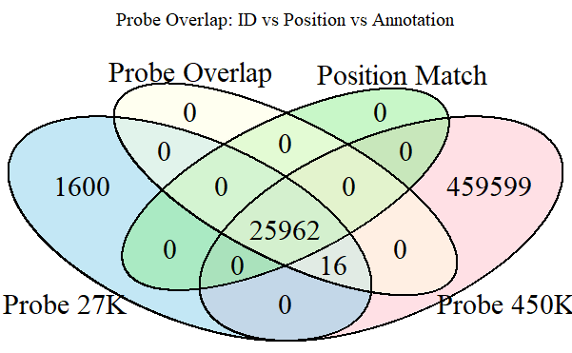
Intra-Cohort Preprocessing
GBM Methylation Array Integration
Problem:
GBM: Only 5 samples profiled on both 27K and 450K arrays
≈ ⅔ GBM samples are 27K format
Need to integrate GBM to 27K format for cross-cohort analysis
Solution:
Extracted overlapping probes (same genomic location) between 27K and 450K
Promoter regions (gene-mappable)

Slide 13
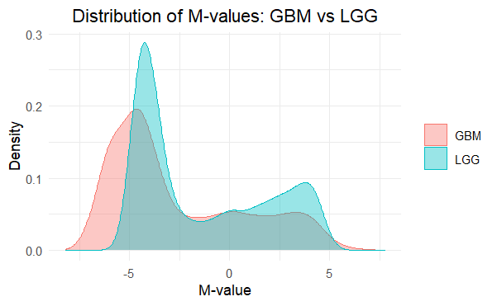
Intra-Cohort Preprocessing
GBM Methylation Array Integration
Convert Beta values to M-values which is more statistically suitable for modelling
M = log₂(Beta/1-Beta)

Slide 14
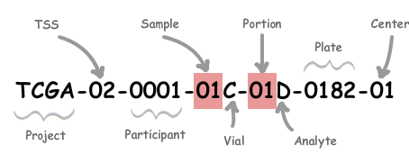
Inter-Cohort Preprocessing
Data Splitting
Purpose: To split into train, validation, internal test and external test dataset
9 : 1
02, 06, 08, 12, 14, 15, 16, 19, 26, 27, 28
Internal dataset
External dataset
7
1.5
1.5
Train dataset
Validation dataset
Internal test dataset
External test dataset

Slide 15
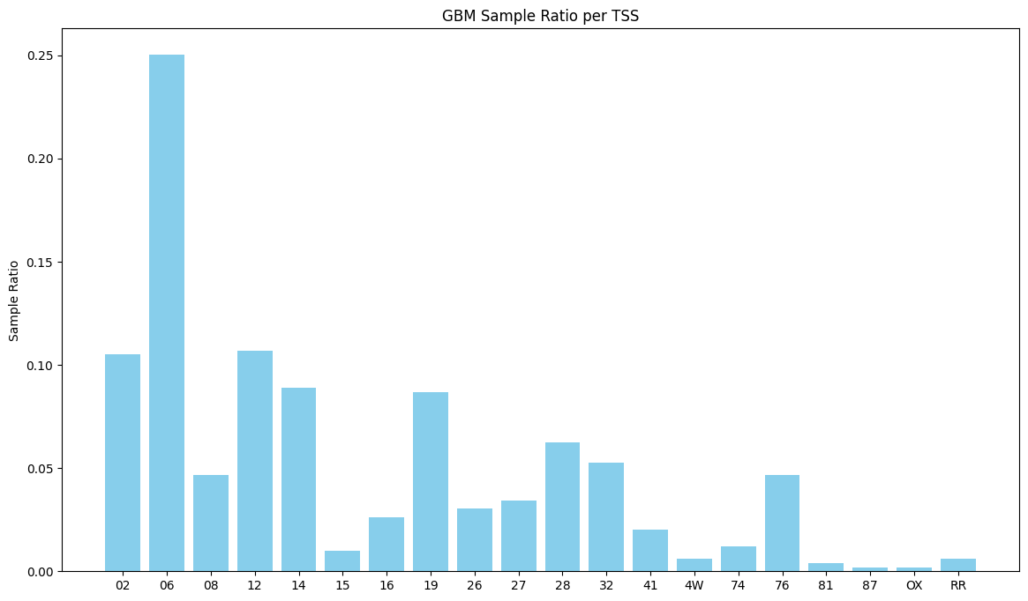
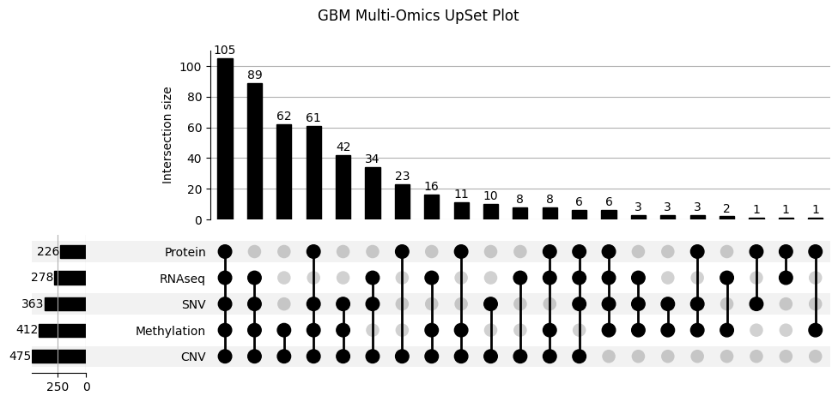
Inter-Cohort Preprocessing
Data Splitting
Problem: The original omics combination distribution needed to be preserved across splits
How to choose TSSs for an external test set (10%)?
How to split train / validation / test (7:1.5:1.5) for the internal set (90%)?

Slide 16
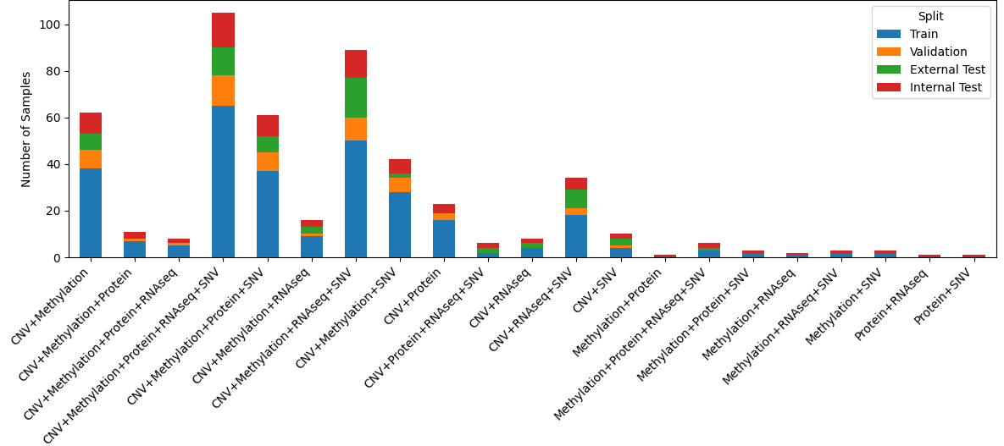
Inter-Cohort Preprocessing
Data Splitting
Solution: Used KL-divergence to preserve the original omics combination distribution
Selected the TSS set (~10%) with the highest KL-divergence score (most similar)
Split the remaining data (~ 90%) into train / val / test (7:1.5:1.5) for each omics layer
1.5
GBM Train: 293 samples
GBM Validation: 55 samples
GBM External Test: 64 samples
GBM Internal Test: 83 samples
LGG Train: 312 samples
LGG Validation: 65 samples
LGG External Test: 66 samples
LGG Internal Test: 72 samples
1.5
7

Slide 17
Inter-Cohort Preprocessing
Feature Filtering
Only training set was used to estimate parameters to avoid data leakage
Problem 1: Features with ≥50% missing values
Solution: Filtered out
4,983 features (8.22%) for the CNV layer
18 features (0.09%) for the methylation layer
23 features (5.91%) for the protein layer
no features (0%) for the RNAseq layer
no features (0%) for the SNV layer

Slide 18
Inter-Cohort Preprocessing
Feature Filtering
Only training set was used to estimate parameters to avoid data leakage
Problem 2: No statistically significant association between disease and sex
Sex is a potential confounder
p-value ≈ 0.14 for both Chi-square and Fisher’s exact tests
Solution: Filtered out sex-related features
located on the chromosomes X and Y

Slide 19
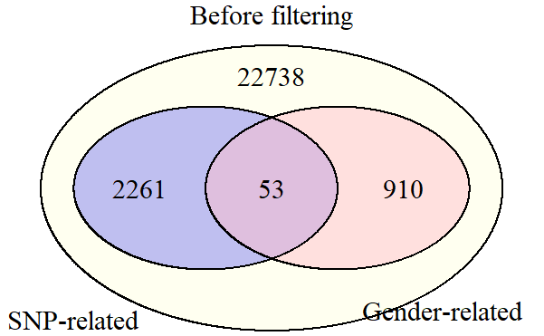
Inter-Cohort Preprocessing
Feature Filtering
Only training set was used to estimate parameters to avoid data leakage
Problem 3: Potential technical artefacts due to known SNPs
Certain methylation probes are known to overlap with SNPs
This may cause spurious signals or unreliable measurements. [6, 7]
Solution: Filtered out SNP-overlapping probes in the methylation layer
Probes removed | # Sex-related | # SNP-related
GBM | 745 | 2,106
LGG | 853 | 2,119

Slide 20
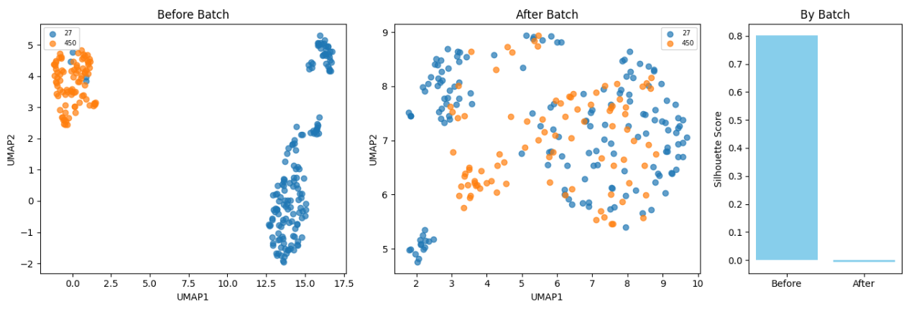
Inter-Cohort Preprocessing
Batch Correction
Problem: The 450K-mapped-to-27K methylation data shows platform bias
Solution:
Used neuroCombat to learn batch parameters from the training set
Applied them to validation and test sets

Slide 21
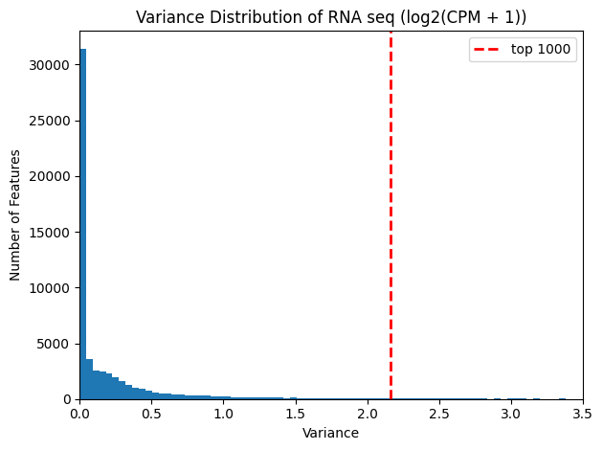
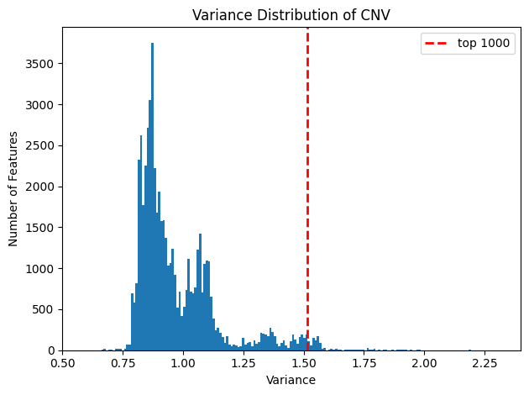
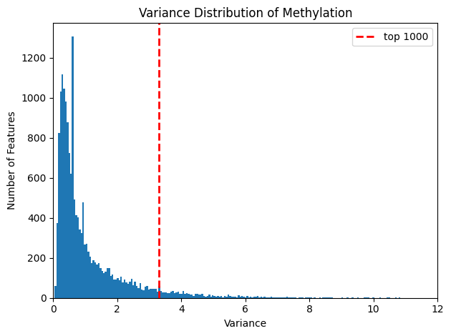
Inter-Cohort Preprocessing
Feature Selection
Problem: DEG/DMR-based feature selection between LGG and GBM may miss hidden subgroups within labels during dimensionality reduction.
Solution: Used feature variance to capture meaningful variation across samples
Selected top 1,000 high-variance features for RNA seq, CNV and Methylation
Used all features for Protein and SNV

Slide 22
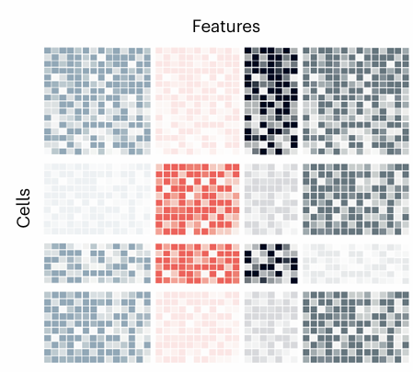
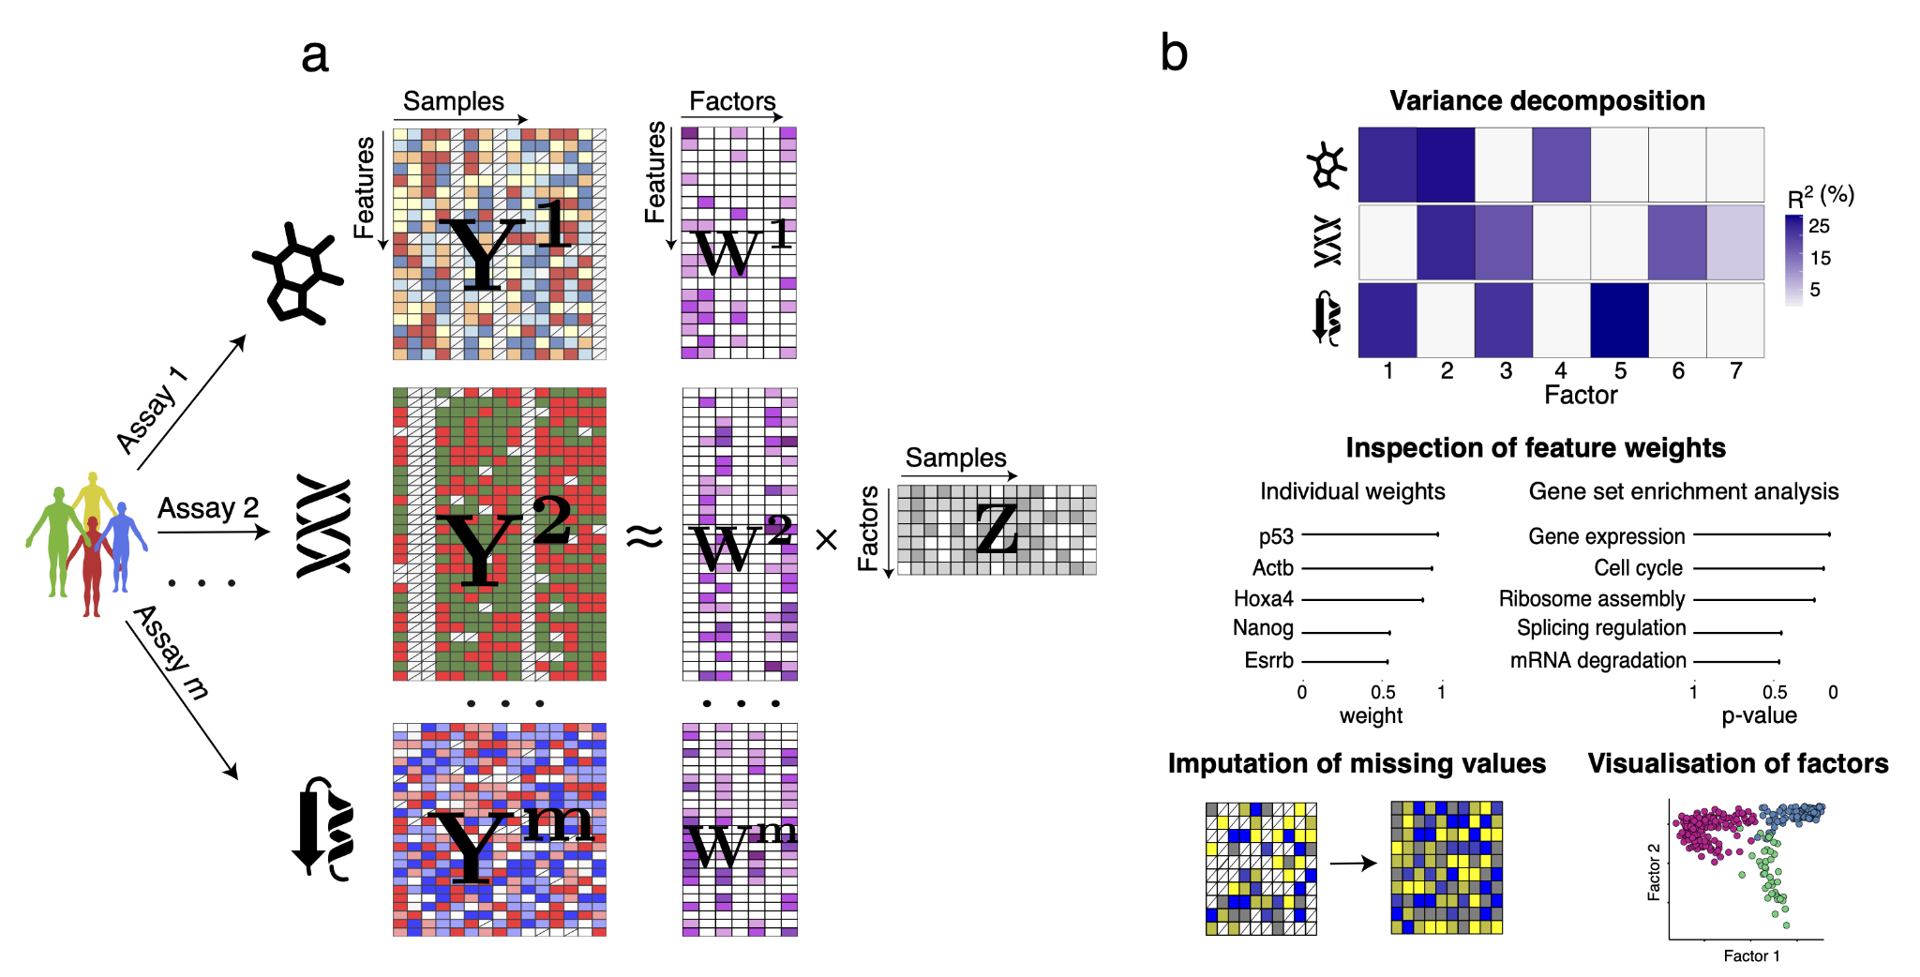
Inter-Cohort Preprocessing
Multi-Omics Integration
Problem 1: GBM and LGG multi-omics datasets have a mosaic data structure
Solution: Used MOFA+, a effective tool for handling mosaic-structured datasets

Slide 23

Inter-Cohort Preprocessing
Multi-Omics Integration
Problem 2: MOFA+ can not infer latent factors (Z) for new data using a trained model parameter
Solution: Extracted the trained weight matrix (W) and applied it to the validation and test sets to compute their latent factors (Z)
Matrix multiplication
Validation and test latent factors
Validation and rest dataset
Trained weight matrix (W)

Slide 24
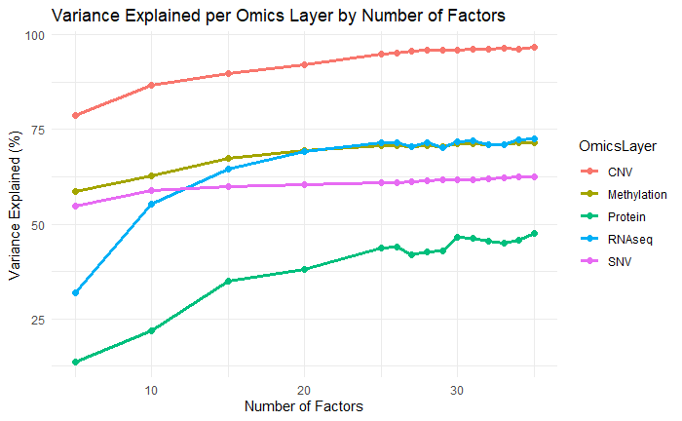
Inter-Cohort Preprocessing
Integration Quality Assessment
Problem: The latent space must capture sufficient information from all omics layers
Solution: Assessed the total variance explained (VE) by each omics layer across factors
30

Slide 25
04
Data Modelling
Applying Machine Learning

Slide 26
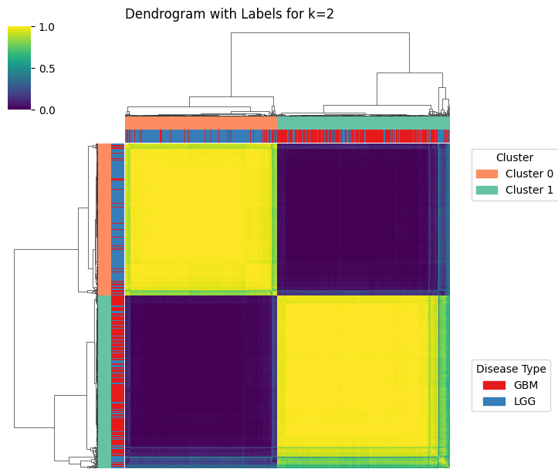
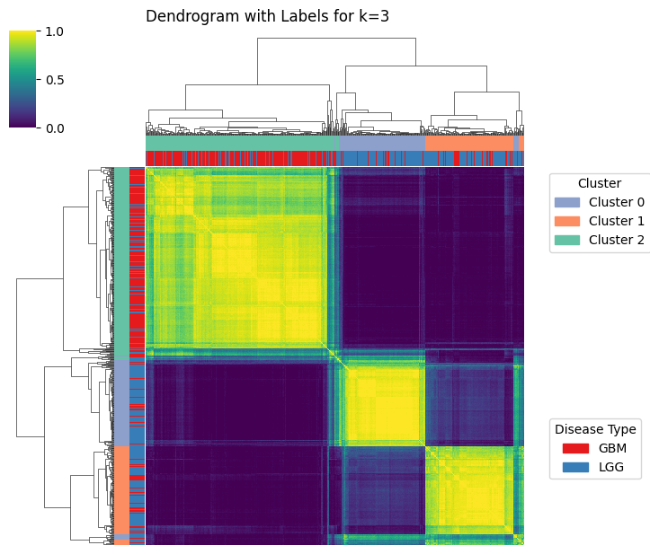
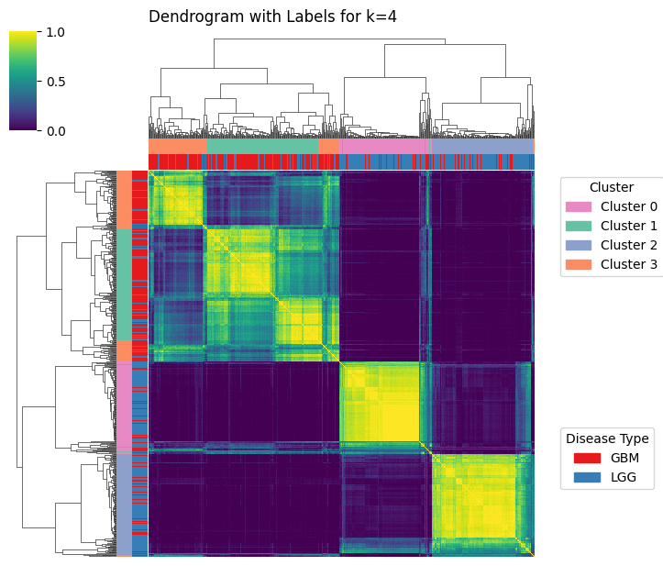
Clustering
Consensus Clustering on the Training Set
Problem: K-means clustering is sensitive to both initialization and sample distribution
Solution: Used a bootstrap-based K-means clustering to improve robustness.
Generated consensus matrix (values in [0,1]) from Training set
Used hierarchical clustering to extract cluster label from the consensus matrix

Slide 27
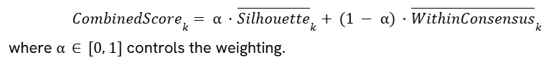
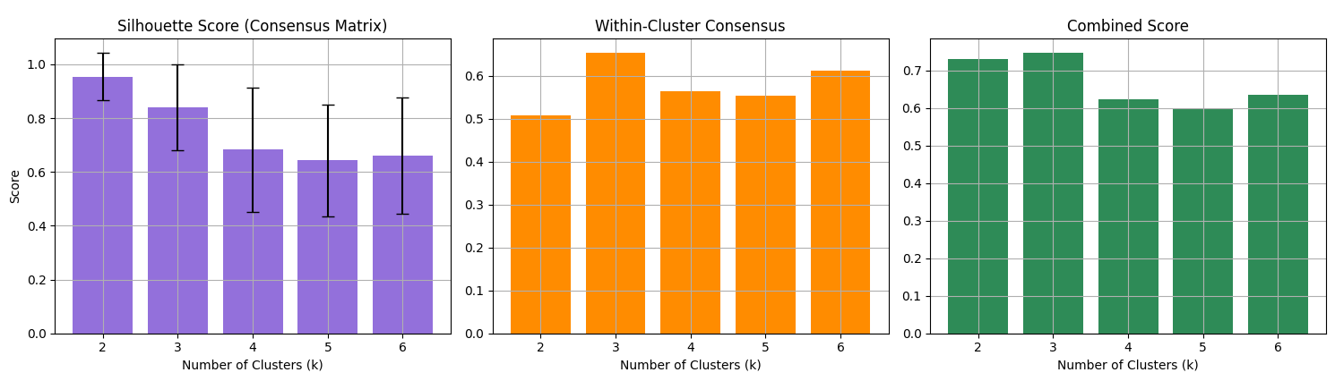
Clustering
Consensus Clustering on the Training Set
Problem: Relying on a single clustering metric can lead to suboptimal or unstable results when determining k.
Solution: Introduced a Combined Score:

Slide 28
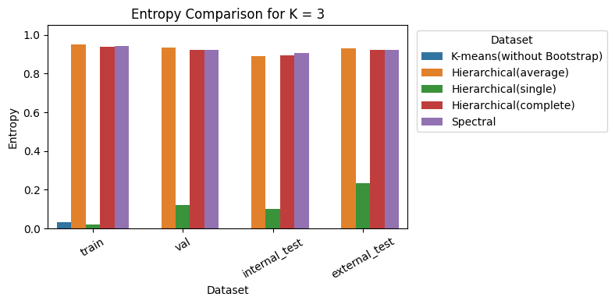
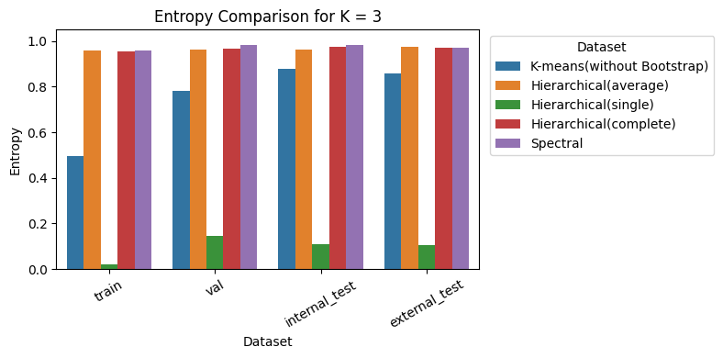
Clustering
Consensus Clustering on the Training Set
Problem: Different methods for assigning cluster labels from the consensus matrix can lead to imbalanced clusters
Solution: Used Shannon entropy to quantify the cluster balance
We used result of ‘Hierarchical- complete’ for later classification

Slide 29
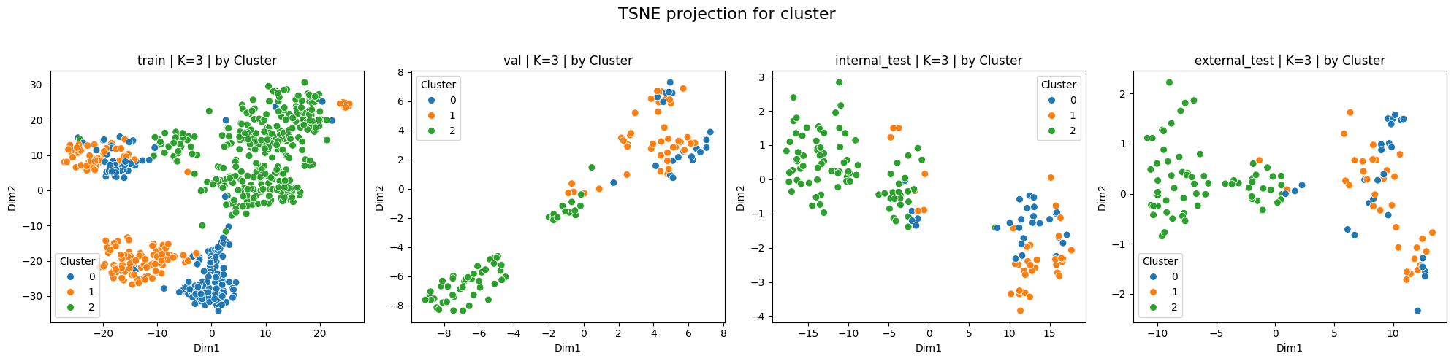
Clustering
Cluster Label Assignment for Validation/Internal/External Test Sets
Computed the distance to cluster centroids in the latent space
Cluster centroids were defined using clusters in Training data
Assigned cluster labels using Euclidean distance

Slide 30
Cluster-Specific Classification
Model Selection
Problem: Different distributions across clusters and smaller sample sizes made it hard to choose suitable models.
Solution: Used bootstrapping to handle distribution uncertainty and select the most robust model for each cluster.
Method
Selected 11 models to find the optimal one for each cluster.
Performed 100 bootstrap iterations on the training set to assess robustness
In each iteration, tuned hyperparameters via grid search
The best model for each cluster was selected based on bootstrap validation F1 score mean and variance

Slide 31
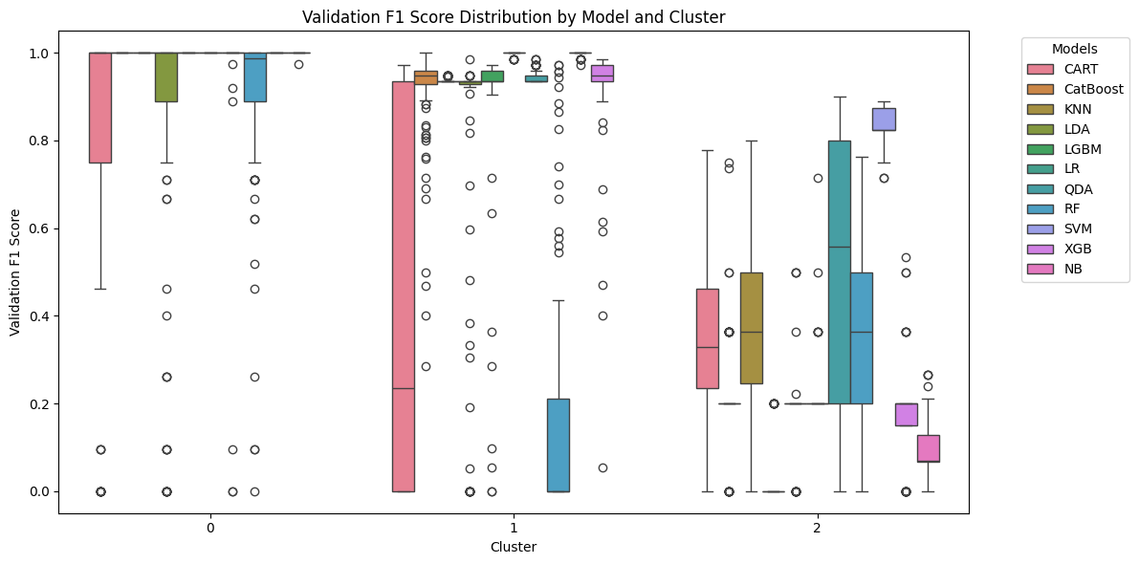
Cluster-Specific Classification
Cluster-wise Model Selection
Support Vector Machine
mean: 1
variance: 0
Logistic Regression
mean: 1
variance: 0.003
Support Vector Machine
mean: 0.83
variance: 0.038

Slide 32
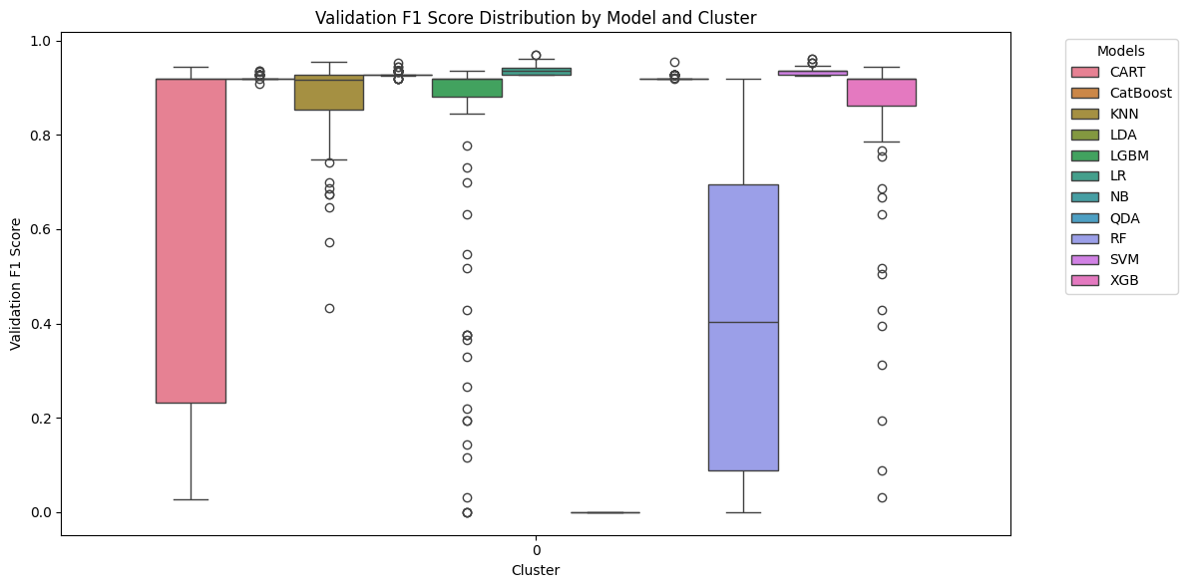
Cluster-Specific Classification
Baseline Model Selection
Baseline model: To compare with our method, we use a model without clustering.
We employ same model selection method.
Logistic Regression
mean: 0.937
variance:0.01

Slide 33
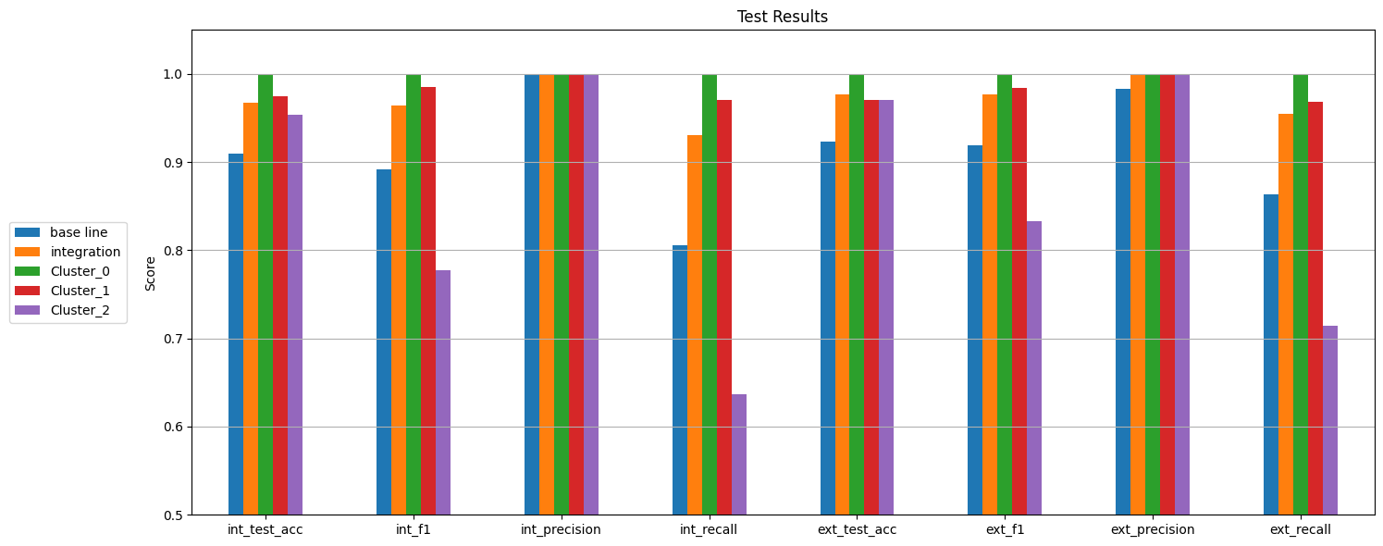
Model Evaluation
Evaluation with Internal and External Test Sets
Integration: Merge all clusters and evaluate overall performance

Slide 34
05
Annotation
Based on Public Knowledge

Slide 35
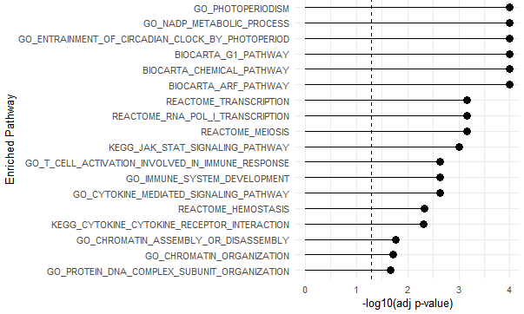
Cluster Annotation
GSEA on Factors
Goal: Characterise latent factors at the functional level
Used curated MSigDBs of MOFAdata:
MSigDB_v6.0_C2_human: Pathways from DBs and literature
MSigDB_v6.0_C6_human: GO terms
Set mean.diff as the gene set statistic
Used parametric t-test with BH correction
▲ Example: Enriched terms for Factor 2
Notes:
Retrieved up to 3 enriched terms per modality per factor
Max 30 terms per factor: 5 modalities x 2 MSigDBs x 3 terms

Slide 36
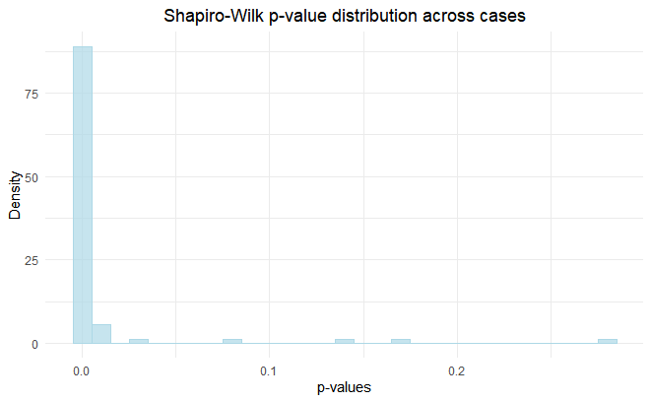
Cluster Annotation
Identification of Discriminative Factors Across Clusters
Problem 1: No prior knowledge of the distribution of factor values
Solution:
Checked the assumptions for t-test
Performed multiple Shapiro-Wilk tests for normality of factor values across cases:
90 cases: 3 clusters x 30 factors
Most distributions of factor values for clusters were not normal
Therefore, used Wilcoxon rank-sum test for pairwise comparisons
Adjusted p-values with BH method

Slide 37
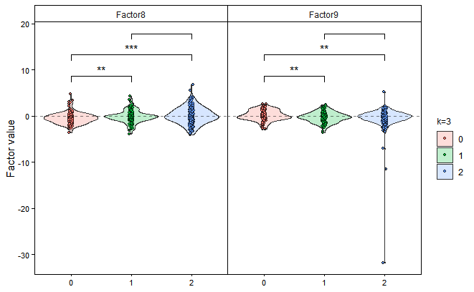
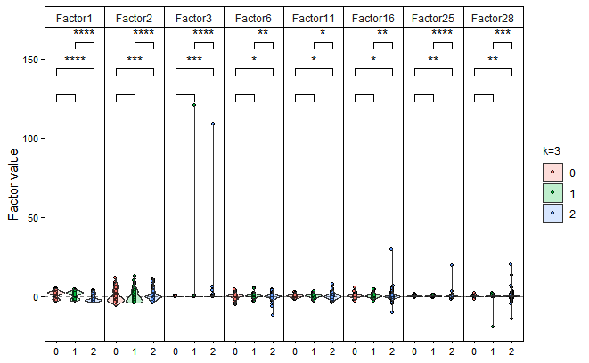
Cluster Annotation
Identification of Discriminative Factors Across Clusters
Problem 2: Interpretation of pairwise comparisons across 3 clusters made it difficult to clearly assign factors to specific clusters
Solution: Used a one-vs-others strategy for annotation
Considered a factor discriminative for a cluster only if it was significantly different in both comparisons: e.g. Cluster 0 vs 1 and Cluster 0 vs 2 ⇒ factor assigned to Cluster 0
ns: p>0.05, *: p≤0.05, **: p≤0.01, ***: p≤0.001, ****: p≤0.0001

Slide 38
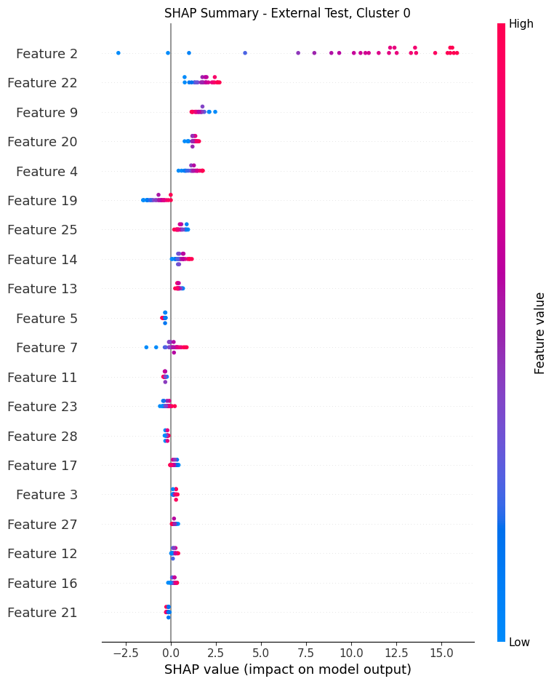
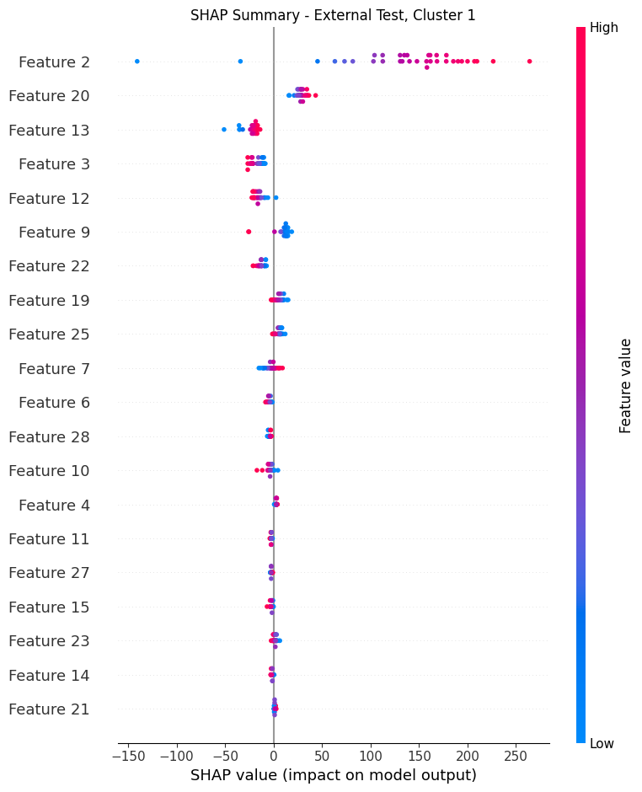
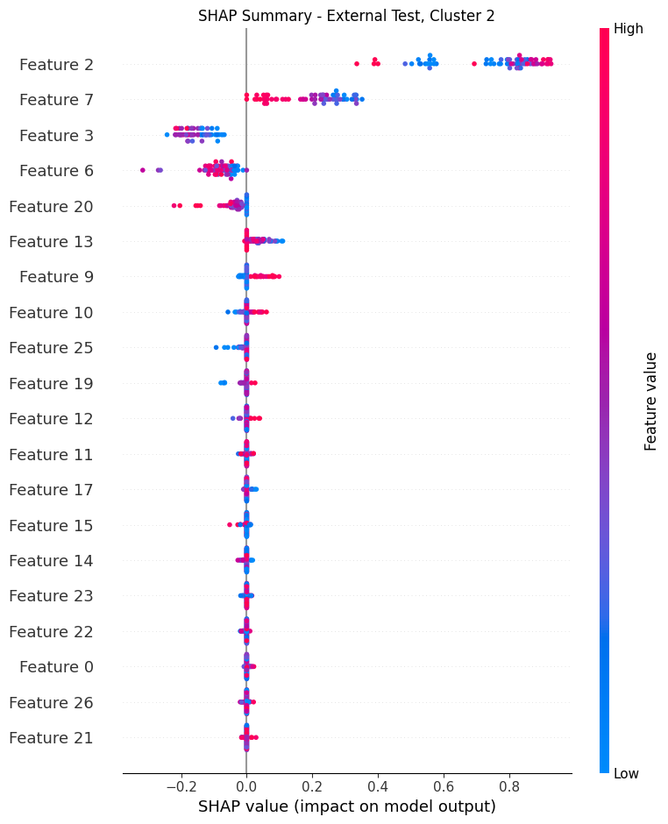
Feature Importance
SHAP Analysis
Problem: Most of the selected models lacked built-in feature importance support
Solution: Applied SHAP analysis to internal and external test sets to interpret model predictions and identify key features

Slide 39
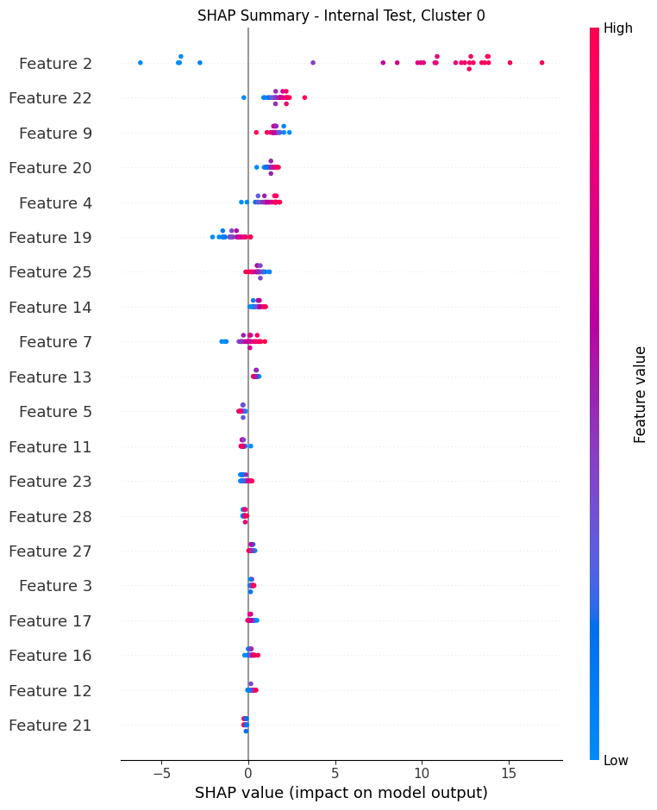
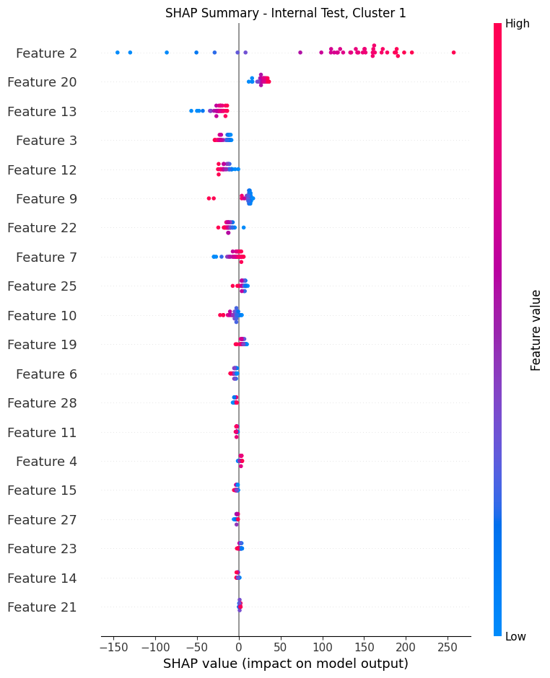
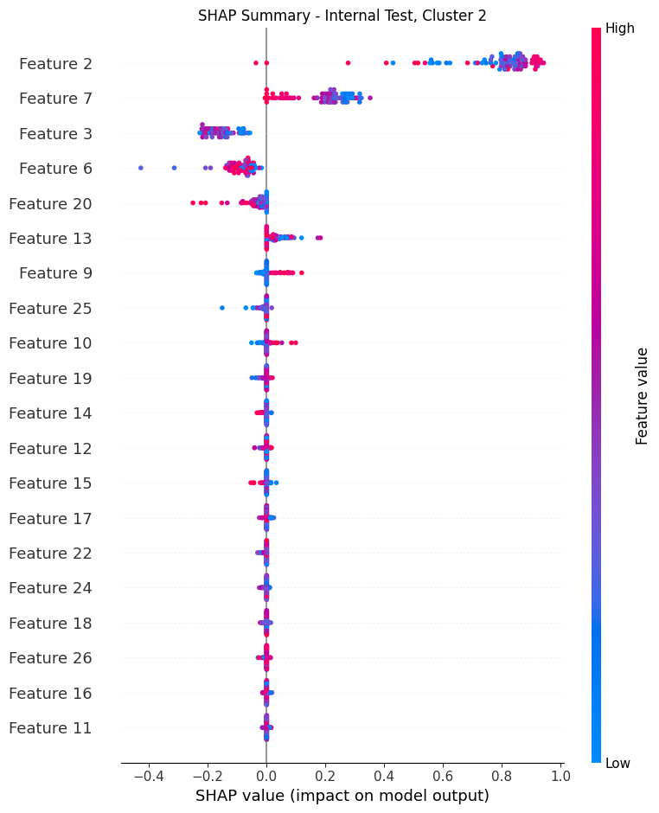
Feature Importance
SHAP Analysis
Global
Local
Global
Local
Factor 2 appears to capture a global discriminative signal between LGG and GBM
The strongest contribution to prediction across all clusters
Distinct features contribute specifically within each cluster:
Cluster 0: Factors 22, 9, 20; Cluster 1: Factors 20, 13, 3; Cluster 2: Factors 7, 3, 6

Slide 40
Feature Importance
Cluster-based Interpretation
GBM-dominant Cluster 2
Best characterised by proliferation, immune signalling, and metabolism:
Factor 1: epithelial proliferation, TCA cycle, glutathione metabolism
Factor 2: cytokine/JAK-STAT signalling
Factor 3: cell cycle, mitotic control
May share immuno-epigenetic modulation:
Factor 6: histone deacetylation, cytokine signalling
Factor 11: STAT5 signalling
LGG vs. GBM separation within Cluster 2
Driven by immune & proliferative gradients:
Factor 7: cytokine/t-cell signalling intensity
Factor 3 and Factor 6
Contribution of Factor 3 and 6 both to cluster definition and grade separation highlighted value of context-specific subgroup analysis
These context-specific signals may be masked in pan-glioma analyses
Notes:
Factor 3 was not discriminative across all samples.
Key message / Future direction ▪ Suggests existence of molecular micro-environments within glioma ▪ Encourages: ✔ Cluster-specific gene module profiling ✔ Single-cell or spatial transcriptomic validation to capture intra-cluster heterogeneity

Slide 41
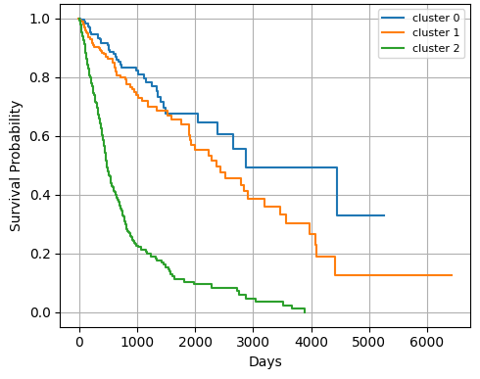
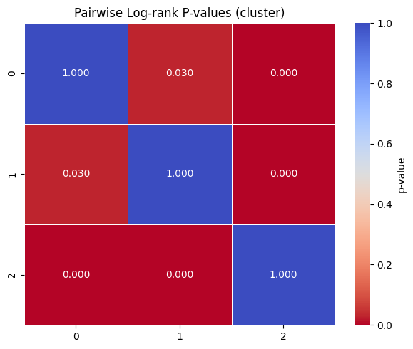
Survival Analysis
Kaplan-Meier Survival Analysis with Log-Rank Test
LGG-
dominant
LGG-
dominant
GBM-dominant
Significant prognostic differences between the clusters (α=0.05)

Slide 42
06
Summary

Slide 43
Conclusion
From Our Project
Proposed a cluster-guided, interpretable classification framework for glioma
Identified ambiguous glioma subgroups via dynamical two-step consensus clustering
Used MOFA+ to generate balanced latent representations across all omics layers after tailored preprocessing
Developed cluster-specific classifiers to enhance predictive performance and biological interpretability

Slide 44
Next Steps
if there is more time
Single-Cell Glioma Atlas
Leverage single-cell data to uncover cellular-level differences behind clusters and enhance biological resolution.

Slide 45
References
Ceccarelli, Michele, et al. "Molecular profiling reveals biologically discrete subsets and pathways of progression in diffuse glioma." Cell 164.3 (2016): 550-563.
Louis, David N., et al. "The 2021 WHO classification of tumors of the central nervous system: a summary." Neuro-oncology 23.8 (2021): 1231-1251.
Reuss, David E., et al. "Adult IDH wild type astrocytomas biologically and clinically resolve into other tumor entities." Acta neuropathologica 130 (2015): 407-417.
Eckel-Passow, Jeanette E., et al. "Glioma groups based on 1p/19q, IDH, and TERT promoter mutations in tumors." New England Journal of Medicine 372.26 (2015): 2499-2508.
Ensenyat-Mendez, Miquel, et al. "iGlioSub: an integrative transcriptomic and epigenomic classifier for glioblastoma molecular subtypes." BioData mining 14 (2021): 1-16.
Chen, Yi-an, et al. "Discovery of cross-reactive probes and polymorphic CpGs in the Illumina Infinium HumanMethylation450 microarray." Epigenetics 8.2 (2013): 203-209.
Meeks, Gillian L., Brenna M. Henn, and Shyamalika Gopalan. "Genetic differentiation at probe SNPs leads to spurious results in meQTL discovery." Communications Biology 6.1 (2023): 1295.

Slide 46
Thank you & Question

Slide 47
07
Supplementary

Slide 48
Intra-Cohort Preprocessing
Sample Filtering
https://docs.gdc.cancer.gov/Encyclopedia/pages/TCGA_Barcode/
Sample: A biospecimen collected from a patient
Problem 1: RNAseq samples with the same patient but different plates
 | # samples of RNA-seq | # samples duplicated across different plates
GBM | 372 | 173
LGG | 516 | 0
Notes:
Sample definition
Problem restatement

Slide 49
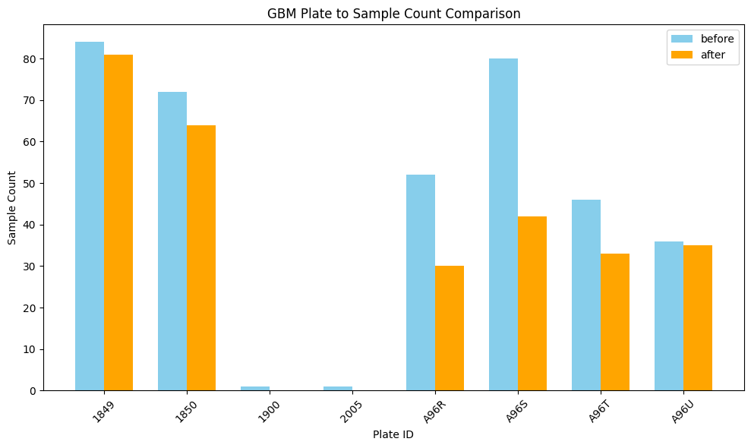
Intra-Cohort Preprocessing
Sample Filtering
Problem 1: RNAseq samples with the same patient but different plates
Solution: Retained only the sample from the most commonly used plate for each patient to minimise potential batch effects, which resulted in the removal of 87 samples.
Notes:
Show the exact number of rows filtered out.

Slide 50
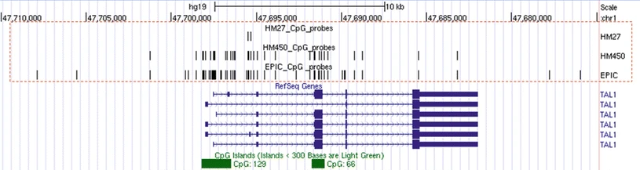
Intra-Cohort Preprocessing
GBM Methylation Array Integration
HM27
HM450
EPIC
https://link.springer.com/rwe/10.1007/978-3-319-31143-2_89-2

Slide 51
Inter-Cohort Preprocessing
Feature Selection
Data type per each omics layers
RNA-seq: log₂(CPM + 1)
Methylation: M-value
CNV: Absolute copy number values
Protein: Normalized RPPA values
SNV: Variant allele frequency (VAF) scores
Notes:
Somatic mutations are a major driver of cancer development. To reflect the biological importance of the SNV layer in the integrated latent representation and to capture glioma heterogeneity, we used the full SNV feature space without prior feature selection. This approach ensures that rare but potentially important mutations—those present in only a few patients—are not excluded due to low variance.

Slide 52
Inter-Cohort Preprocessing
Feature Selection
Method
LGG and GBM samples were combined to compute feature-wise variance.
Top 1,000 high-variance features were selected for RNA-seq, CNV, and methylation to ensure balanced contributions in MOFA+.
All protein and SNV features were retained:
Protein: Low dimensionality minimizes noise.
SNV: All features were preserved to capture rare but biologically important somatic mutations often missed by variance-based selection.
→ Somatic mutations are key drivers in cancer; retaining the full SNV space helps capture glioma heterogeneity in the latent representation.
Outcome
This strategy improved the quality of MOFA+ latent factors, enhancing both clustering stability and classification performance.

Slide 53
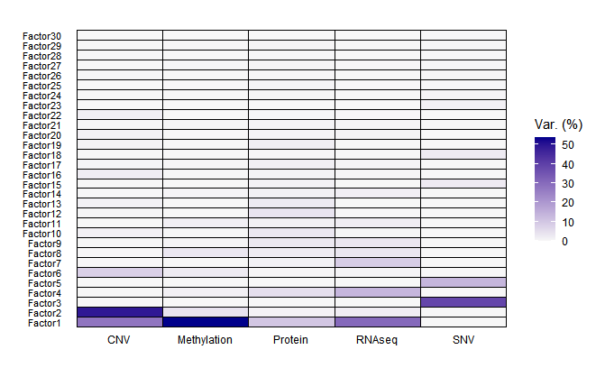
Inter-Cohort Preprocessing
Integration Quality Assessment

Slide 54
Cluster-Specific Classification
Cluster-wise Model Selection

Slide 55
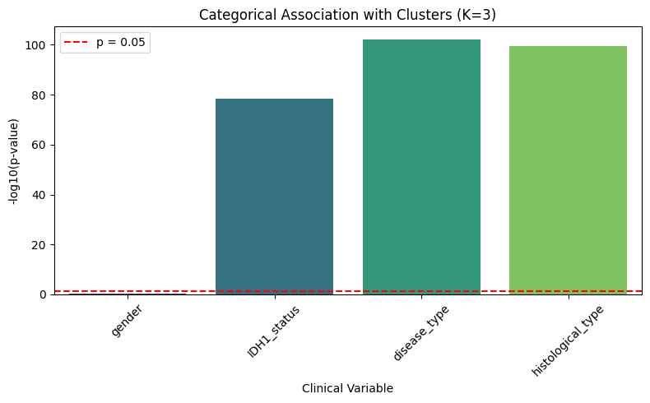
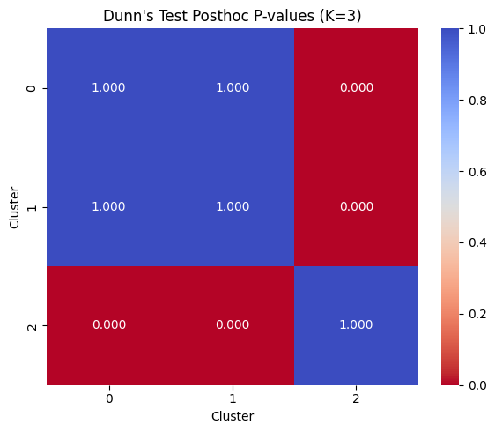
Cluster Annotation
Comparison with known clinical and molecular variables
Chi-square test for categorical variables (Left)
Dunn’s Test on Age at Diagnosis (Right)

Slide 56
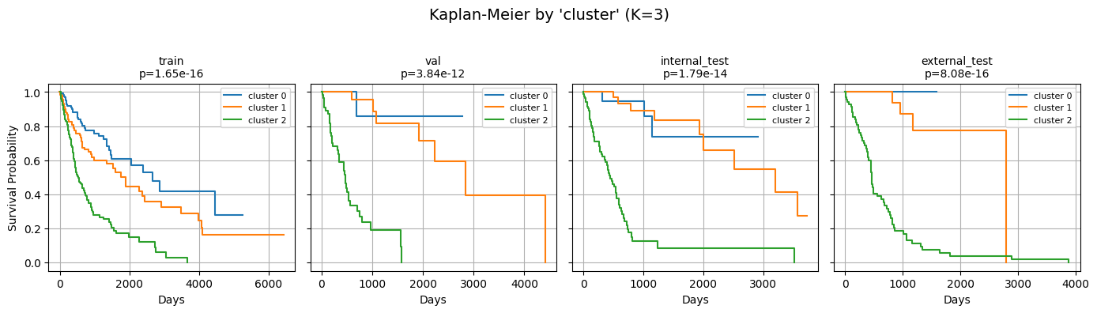
Survival Analysis
Kaplan-Meier Survival Analysis with Log-Rank Test
Group by Clusters

Slide 57
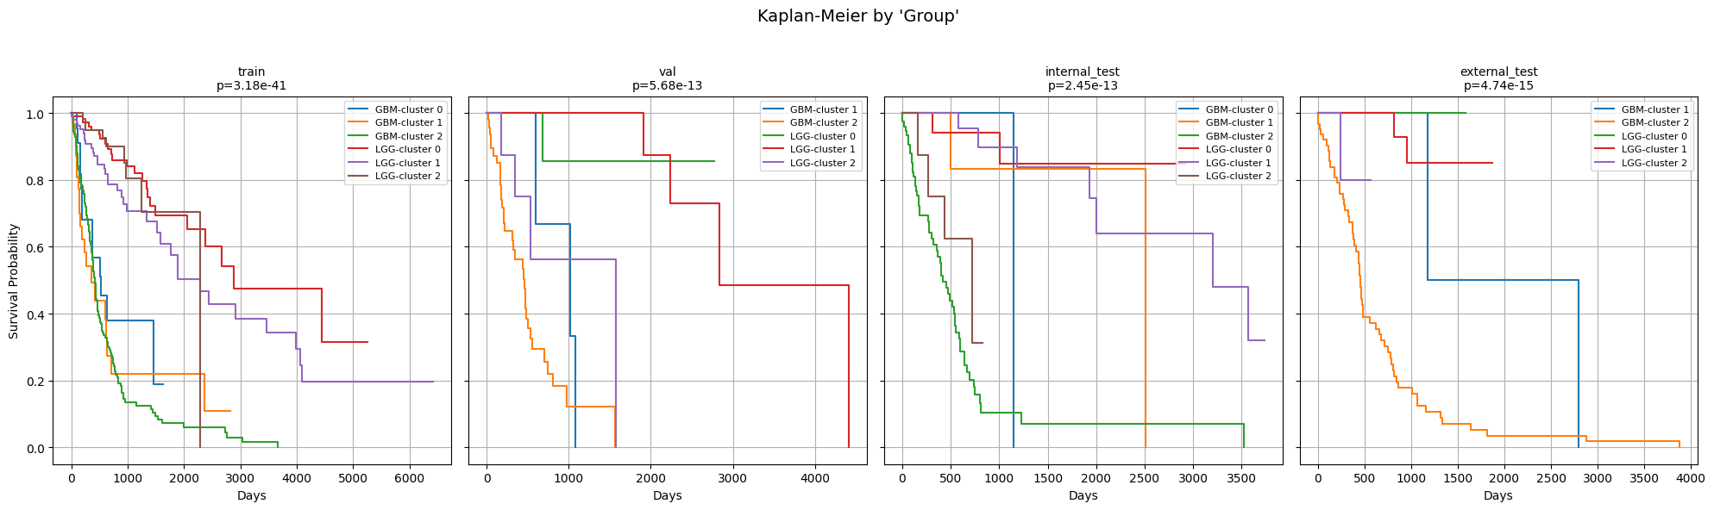
Survival Analysis
Kaplan-Meier Survival Analysis with Log-Rank Test
Group by Subtype (GBM/LGG) + Cluster label(0/1/2)

Slide 58
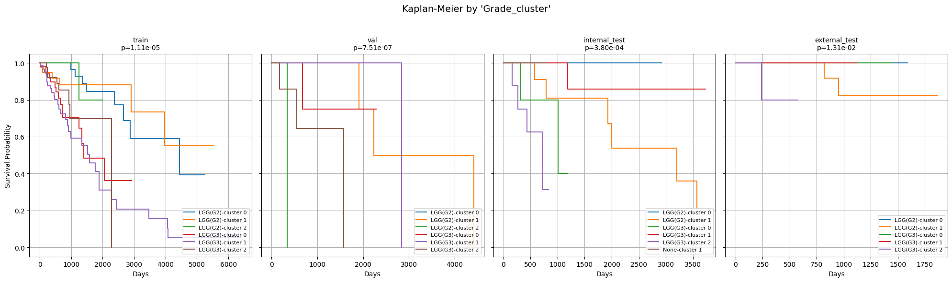
Survival Analysis
Kaplan-Meier Survival Analysis with Log-Rank Test
Group by Grade: GBM vs LGG (G2) vs LGG(G3) + Cluster label(0/1/2)

